Slide 1

Aviation Risk Analysis
Presented by:
Michael Kamuya

Slide 2
Aviation Risk Analysis
This walkthrough explores real accident data to help us make smart aircraft investment decisions.
Data analysis using pandas
Visuals were built in Tableau, and you can find more of my work on GitHub: github.com/michaelmakao

Slide 3
Business Context
So here’s the deal!The company wants to expand into new industries.
Aviation is a top pick, with plans to operate commercial and private aircraft.
To do this right, we need to know: which aircraft models come with the lowest risk?
This analysis gives us clear data-backed guidance on where to invest safely.

Slide 4
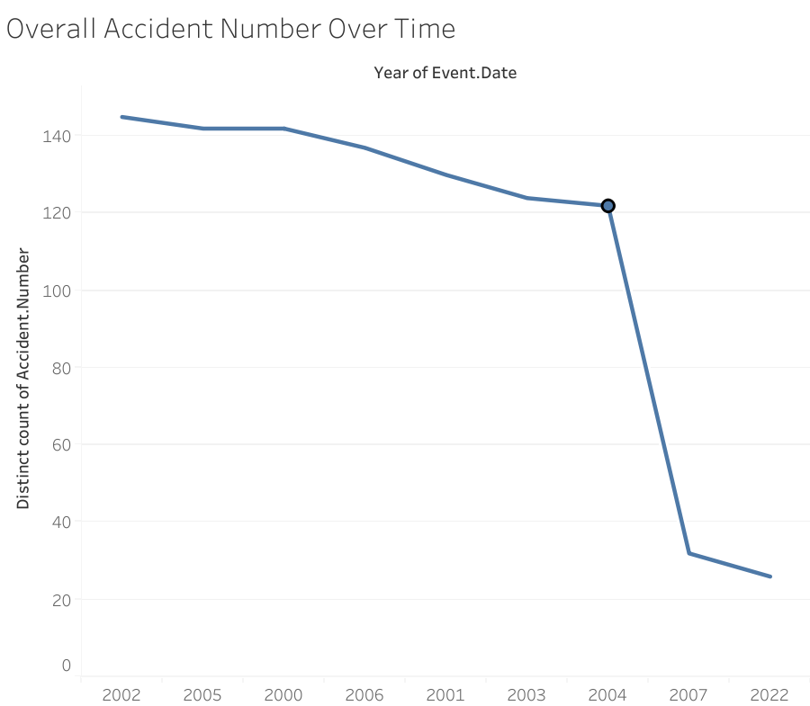
Data Understanding
I’m working with aviation accident data from the NTSB — it covers 1962 through 2023.
We’re looking at over 90,000 accident records from around the world.
I also pulled out year and month to visualize trends over time.
Key data points include:
aircraft make
engine type
injury severity
Weather
phase of flight.

Slide 5
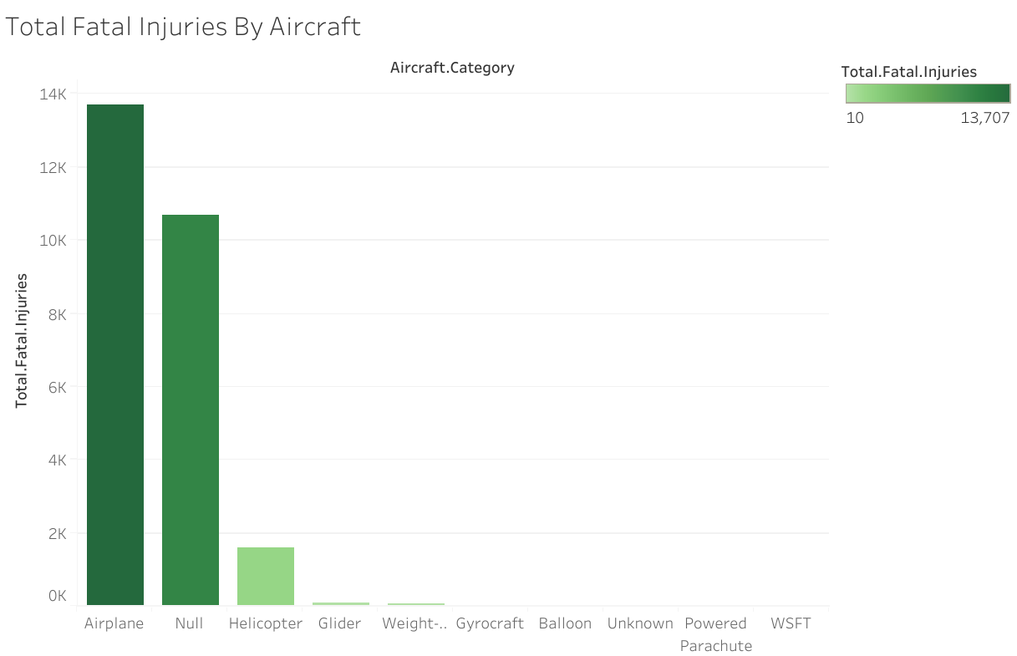
Data Analysis Process
I filled in missing text fields like engine type with 'Unknown'.
Numeric gaps were filled using medians or zeros depending on the context.
Rows without injury severity were dropped to maintain data quality.
All this was done using Python. The dashboards were created using Tableau.

Slide 6
Fatal Injuries by Aircraft Category
Here’s what stands out: airplanes are responsible for the highest number of fatal injuries by far.
Helicopters are next — though much lower — and 'Null' likely means unclassified aircraft.
This tells us airplane operations need the most attention in terms of safety.

Slide 7
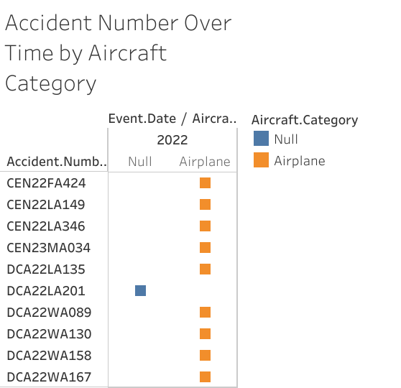
Accidents by Aircraft Category Over Time
This chart tracks accident trends by aircraft type across the years.
Airplanes consistently show the highest count, but we do see a gradual decline.
The drop in incidents for Cessna models is especially encouraging.

Slide 8
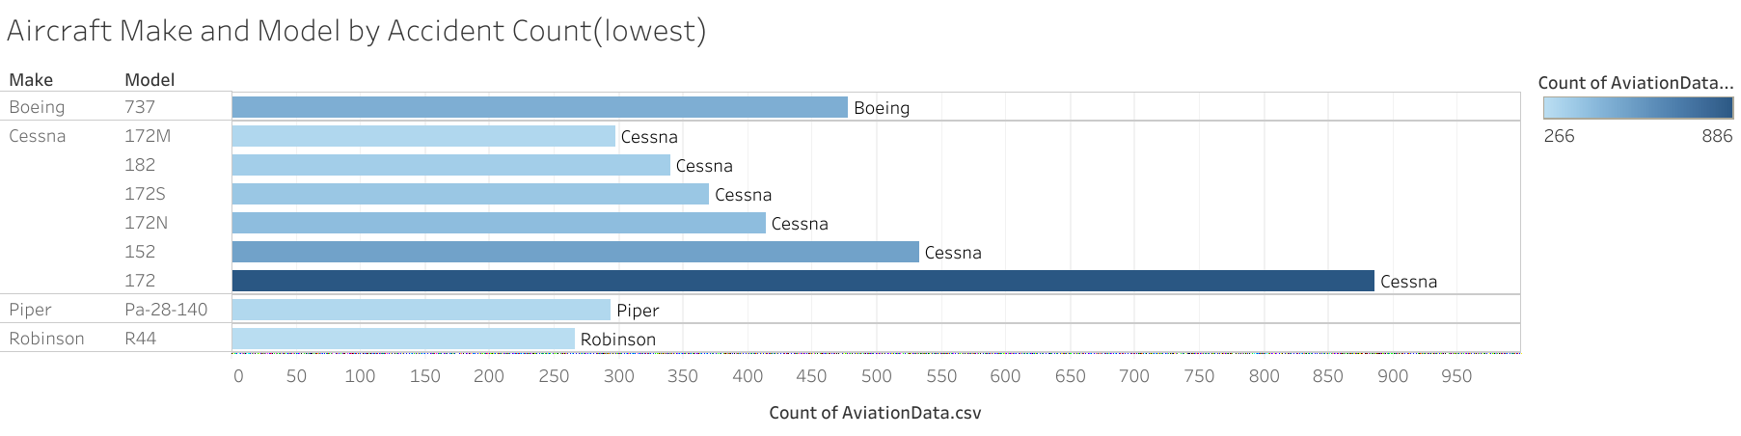
Safest Aircraft Models
Here, I’ve ranked aircraft by how few accidents they’ve had.
ULTR and Rocket types appear to be some of the safest categories.
If we’re aiming to reduce operational risk, these are strong candidates to consider.

Slide 9
Insights and Business Applications
Cessna models are showing fewer incidents over time — that's a good sign.
Airplanes need more operational caution, especially during takeoff and landing.
Weather plays a huge role — most fatalities happen in ICM (instrument conditions), not VMC (visual).

Slide 10
Recommendations
Approach
Cautiously approach reciprocating engines — hybrid rockets seem safer.
Avoid
Avoid scheduling flights during months with high ICM risk — especially July onward
Consider
Consider aircraft models like Robinson that have lower accident records
Prioritize
Prioritize take off and landing protocols — that’s where most issues occur.

Slide 11
Future Opportunities
We could add cost data to compare safety with budget options.
It might help to calculate accident rates per flight hour if that data becomes available.
Integrating weather forecasts could help us avoid seasonal spikes in risk.
As we expand, we’ll need a system for tracking ongoing aircraft safety metrics.

Slide 12
Thank You !
Thanks for sticking with me through this walkthrough!
Happy to answer any questions or dive deeper into the data with you.

